Slide 1


SPAM
DETECTION

Slide 2

THE TEAM
Abhay sharma
2105337
Manish Kumar
21051659
Harsh Gupta
21051651
Sayan Mondal
21051512
Abhinav Bisht
21051704

Slide 3



Table of
CONTENTS
01
02
03
Introduction
Dataset
Methodology
04
05
06
Model
Result
Conclusion

Slide 4


INTRODUCTION
Spam has been a major concern given the offensive content of messages, spam
is a waste of time. End user is at risk of deleting legitimate mail by mistake.
Moreover, spam also impacted the economical which led some countries to adopt
legislation.
Text classification is used to determine the path of incoming mail/message either
into inbox or straight to spam folder. It is the process of assigning categories to text
according to its content. It is used to organized, structures and categorize text. It can
be done either manually or automatically. Machine learning automatically classifies
the text in a much faster way than manual technique. Machine learning uses
pre-labelled text to learn the different associations between pieces of text and it
output. It used feature extraction to transform each text to numerical representation
in form of vector which represents the frequency of word in predefined dictionary.

Slide 5
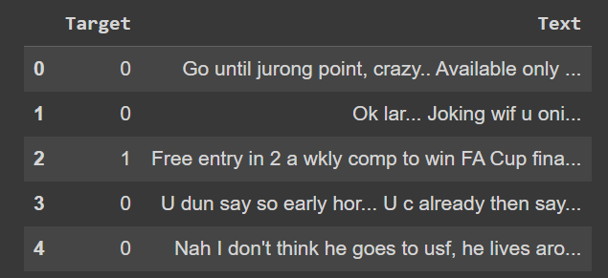
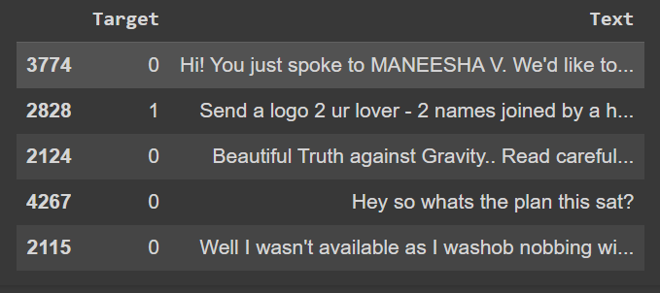
DATASET
This dataset was taken form Kaggle and is part of a larger dataset called Enron. This dataset contains a set of spam and non-spam emails with 0 for non spam and 1 for spam in label attribute.
Composition :
Unique values : 5573
Spam values : 747
Non-spam values : 4826

Slide 6

METHODOLOGY
Vectorization
Naive Bayes
TF-IDF stands for Term Frequency-Inverse Document Frequency. It is a technique that assigns scores to words based on their frequency in a document and across a collection of documents. These scores are used to represent text numerically for tasks like document classification or clustering. It helps identify the importance of words in documents relative to the entire corpus.
TF: (Number of times the terms appear in the document / Total number of terms in the document)
IDF: log (Number of documents in the corpus / Number of documents in the corpus containing the term)
TF-IDF: TF * IDF
The Naive Bayes (NB) model is a simple but effective machine learning algorithm based on Bayes' theorem particularly popular for text classification tasks (like spam detection or sentiment analysis) due to its simplicity and efficiency, especially when dealing with many features.
It is called "naive" because it assumes independence among features, meaning it assumes that the presence of one feature is independent of the presence of any other feature.
P(A|B) = ((P(B|A) * P(A)) / P(B))

Slide 7


MODEL
Text Pre-Processing
Feature vectors data
Dataset
Training data
Testing data
User Input
Text Pre-Processing Feature vectors data
Naive Bayes
Used for result and analysis
Predictions

Slide 8
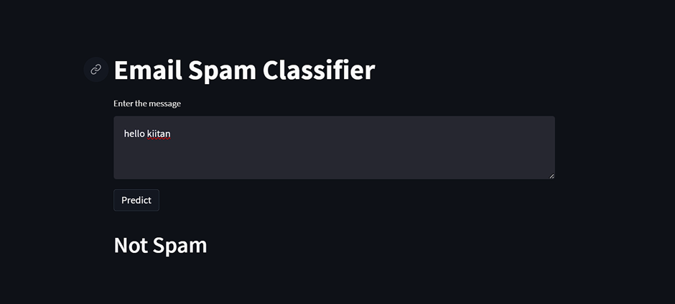

RESULTS
After comparison with the original testing data the model accuracy is found to be around 0.9612 i.e. 96% .
The figure correspond shows some example of output of the model

Slide 9

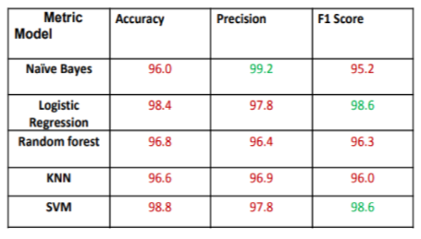
COMPARISON

Slide 10
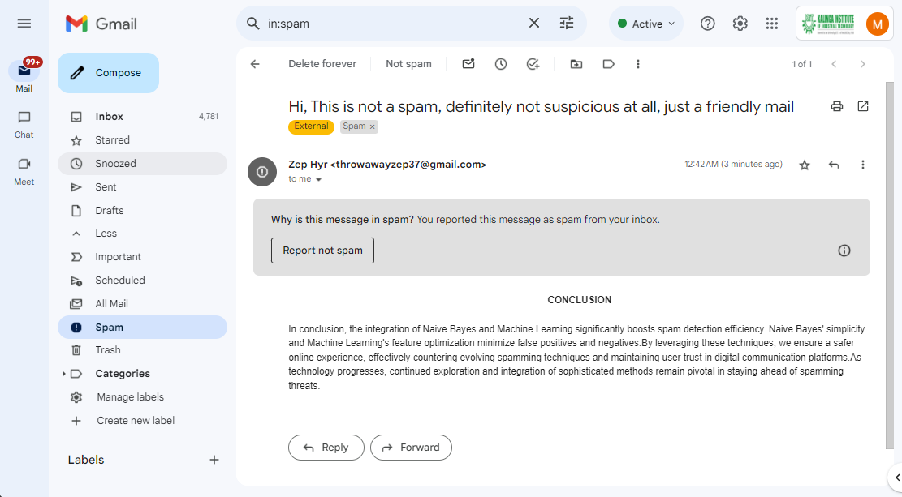

Slide 11



